Slide 1
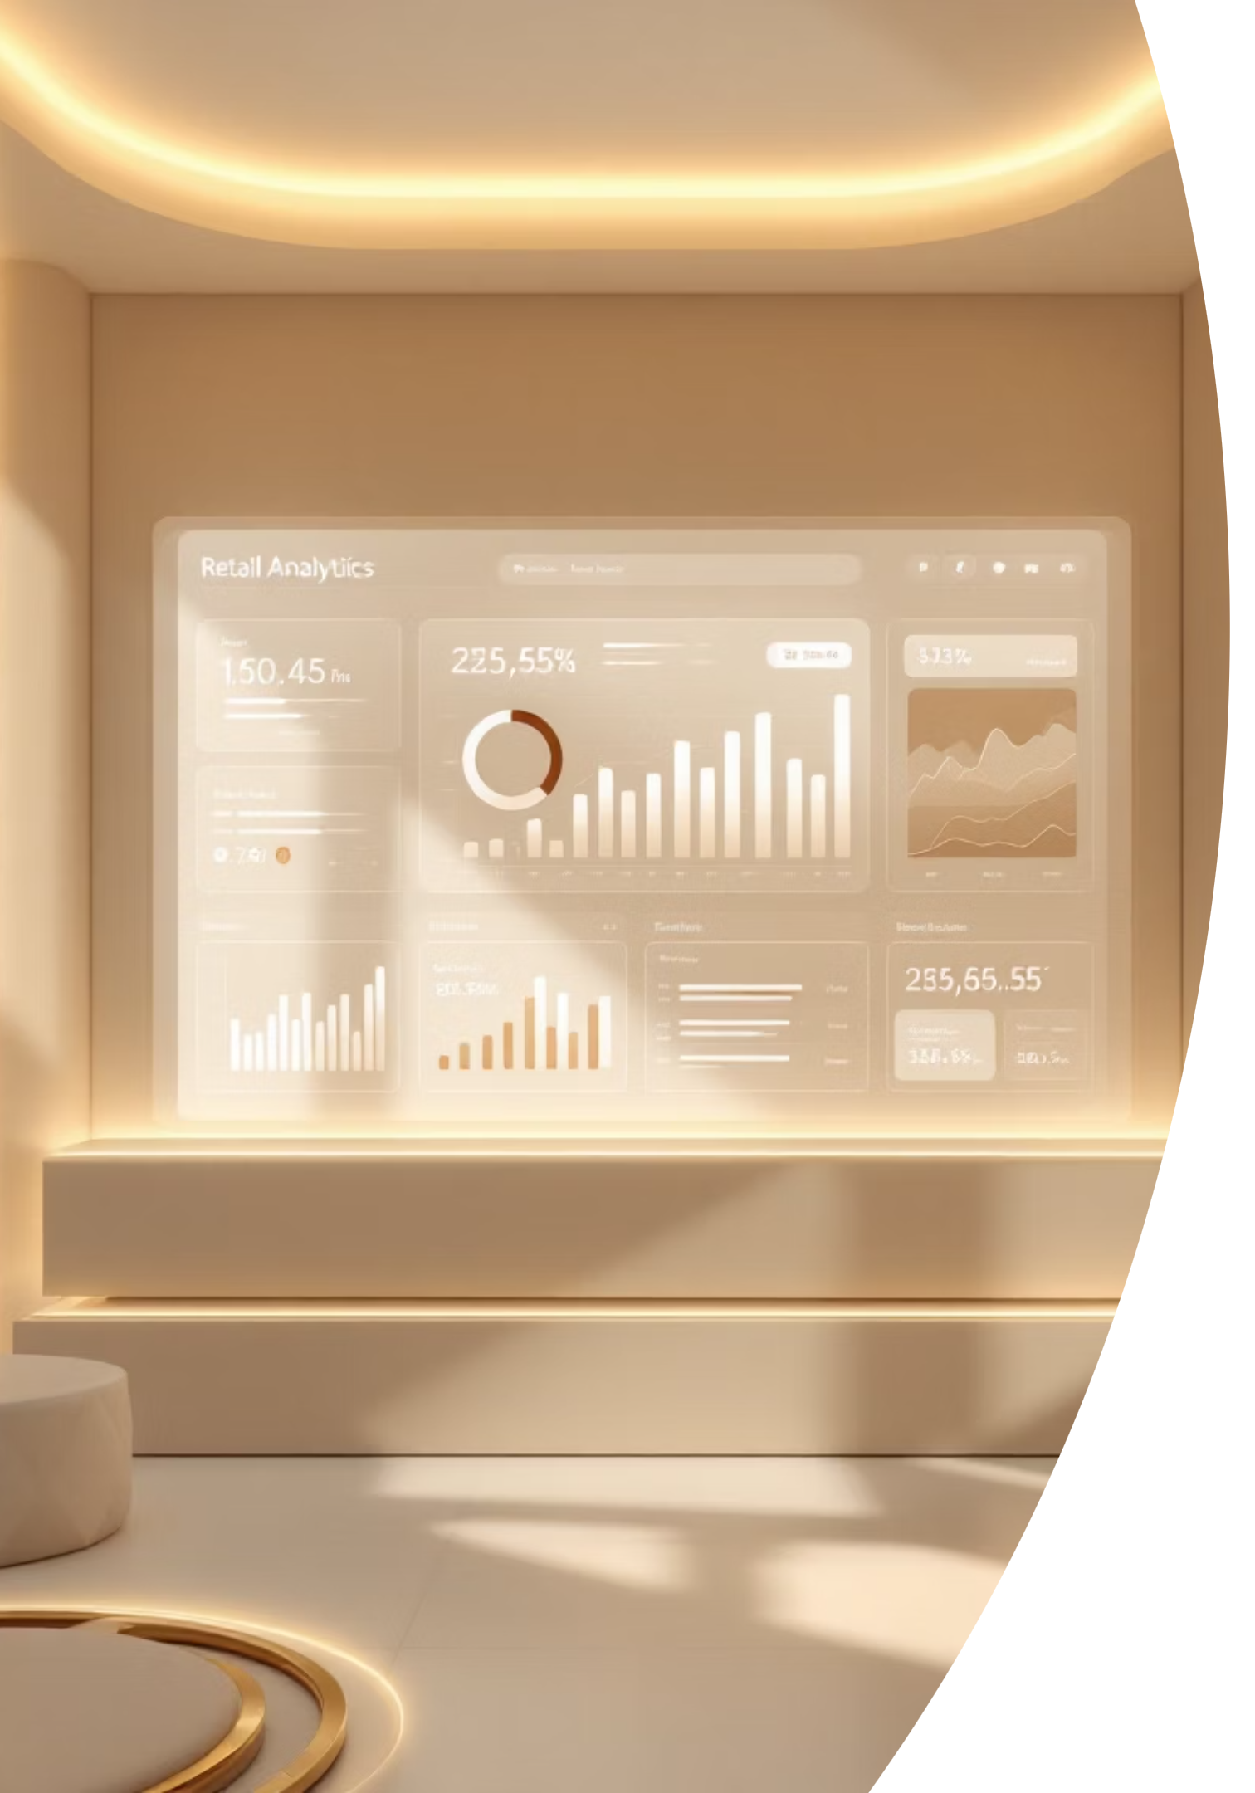
Retail Analytics Dashboard
Data-Driven Insights for Smarter Retail Decisions
Rushal Nikam

Slide 2

The Untapped Potential of Retail Data
Retail businesses generate an enormous volume of data daily, from transaction records to customer interactions and inventory movements. However, without proper analysis, this wealth of information often remains unused, failing to translate into tangible business advantages.
Vast Data Volume: Retail operations produce extensive datasets daily, encompassing sales, customer behavior, and inventory.
Raw Retail Data
Data Underutilization: Much of this raw data remains unanalyzed, representing a missed opportunity for strategic growth.
Data Processing
Analysis
Demand for Insights: There is a critical need for actionable insights derived from this data to understand customer preferences, optimize sales strategies, and identify emerging market trends.
Actionable Insights
Our goal is to transform this raw data into clear, actionable intelligence that empowers retail managers and stakeholders to make informed, strategic decisions.

Slide 3






Achieving Clarity: Project Objectives
This project aims to convert complex retail data into transparent, actionable insights. By focusing on key areas, we empower stakeholders with the information needed to drive business success and optimize performance.
Data Preprocessing
Customer Behavior
Clean and prepare raw retail data, ensuring accuracy and consistency for reliable analysis.
Analyze purchasing patterns, preferences, and demographics to understand customer segments deeply.
Performance Tracking
Interactive Dashboards
Monitor product and regional sales performance to identify top sellers and underperforming areas.
Build intuitive Power BI dashboards for dynamic exploration and data-driven decision-making.

Slide 4





Our Analytical Journey: Methodology
Our approach integrates powerful analytical tools and robust visualization techniques to create a seamless flow from raw data to compelling insights, ensuring every step is precise and purposeful.
Data Processing with Python
Utilize Python in Jupyter Notebooks for efficient data cleaning, transformation, and statistical analysis.
Dynamic Visualizations
Employ Matplotlib, Seaborn, and Plotly to create informative and engaging data visualizations.
Power BI Dashboard Design
Develop interactive and user-friendly dashboards in Power BI for comprehensive business intelligence.
Integration & Insight Delivery
Seamlessly integrate data sources and dashboards to provide real-time, actionable insights for strategic planning.

Slide 5


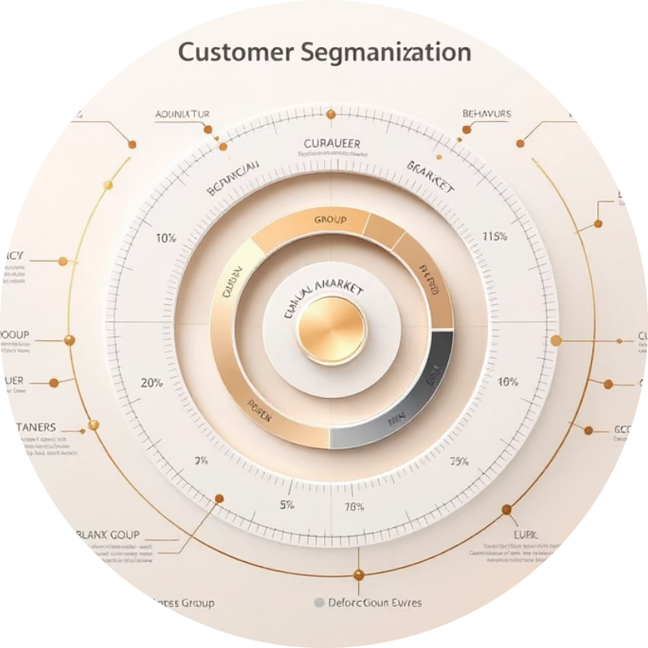

Unlocking Value: Key Insights & Visuals
Through rigorous analysis, we extract critical insights that illuminate business performance and identify growth opportunities. These findings are presented through intuitive visuals, making complex data easily digestible.
Seasonal Sales Trends
Top Products & Categories
Customer Segmentation
Regional Revenue Variations
Identify peak seasons and low periods to optimize inventory and marketing efforts.
Understand distinct customer groups to tailor personalized marketing strategies.
Pinpoint best-performing items and categories driving the most revenue.
Analyze geographic performance to allocate resources effectively and target growth areas.

Slide 6


Conclusion & Future Vision
This Retail Analytics Dashboard empowers managers with a robust, interactive tool for data-driven decision-making, transforming raw data into a strategic asset. The insights gained will help optimize retail strategy, enhance customer experiences, and drive sustainable growth.
Key Takeaways
Optimized Strategy: Data-driven insights refine retail operations and business strategy.
Interactive Exploration: The Power BI dashboard offers dynamic data analysis.
Next Steps: Advancing Analytics
Our journey doesn't end here. Future enhancements will include:
Predictive Analytics: Forecasting future sales and trends.
Recommendation Systems: Personalizing product suggestions for customers.
Thank You for Your Time and Attention!

